Slide 1
Internet Banking
Group 2

Slide 2

INTRO
Develop an Internet Banking Application, that will enables customer to perform their basic banking transactions on the go using PC or laptop.

Slide 3



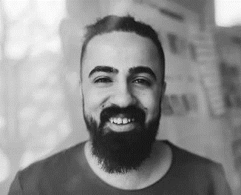



MEET OUR TEAM
Shrikant yadav
Neha Chand
Burute, Swapnali Shivadas
Sarguru, Affan
Chief Executive Officer
VP Marketing
Chief Operations Officer
Tanmay pednekar
Pranav Kanekar
Dhale, Reshma Hemant​
Teaa
Product Designer

Slide 4
Agile MEtHOD
It is about building benchmarks and accountability into your plan, and using them to evaluate the plan as you go and after the project is finished.
Planning
how we are going to complete a project in a certain timeframe, usually with defined stages and designated resources.
Design
We finally decided to create your
1.Use case diagram
2.Class diagram
3.Exel sheet
Implementation
Your group knows the problems/issues in your community, you have consulted the community and developed a project plan with specific crime prevention activities to address those problems/issues and you are ready to start the project.
The process of executing a program to find errors. To make our software perform well it should be error-free.
Test
Evaluation

Slide 5
TIMELINE
SEP 9/9/22 | PLANING
SEP 12/9/22 | DESIGN
SEP 12/9/22 SEP
 | EVALUTION
DEVELOPMENT
TESTING
18/9/22
SEP
20/9/22

Slide 6
Problem statement
Develop an Internet Banking Application, that will enables customer to perform their basic banking transactions on the go using PC or laptop.

Slide 7
Use case Diagram
Create User
Account
Manage Accounts and Transaction
Deposit
Withdraw
ADMIN
Customer
Transfer
Record of transaction

Slide 8
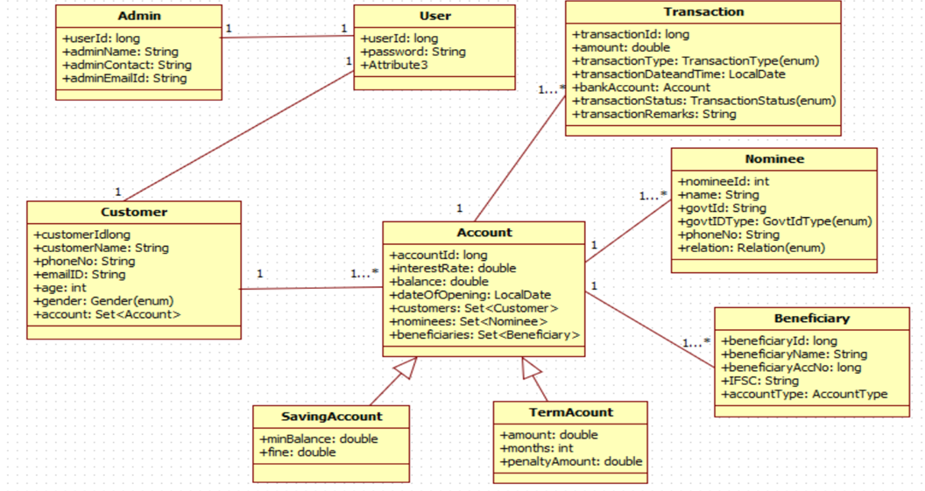

Slide 9




AREAS OF FOCUS
B2B MARKET SCENARIOS
Develop winning strategies to keep ahead of the competition​
Capitalize on low-hanging fruit to identify a ballpark value​
Visualize customer directed convergence
CLOUD-BASED OPPORTUNITIES
Iterative approaches to corporate strategy​
Establish a management framework from the inside

Slide 10

SUMMARY
Online banking allows a user to conduct financial transactions via the Internet. Online banking is also known as Internet banking or web banking. Online banking offers customers almost every service traditionally available through a local branch including deposits, and transfers

Slide 11
THANK YOU
Mirjam Nilsson
mirjam@contoso.com
www.contoso.com

